Slide 1
Muscle physiology

Slide 2
Unit 1

Slide 3
Muscle
Muscle is derived from the Latin word ‘musculus’ meaning mouse, because of its shape.
The primary function of the muscle is for locomotion or movement.
It also helps in maintaining posture, movement of internal organs (such as movement of food through the gastrointestinal tract), in speech, respiration and in pumping blood out of the heart.

Slide 4
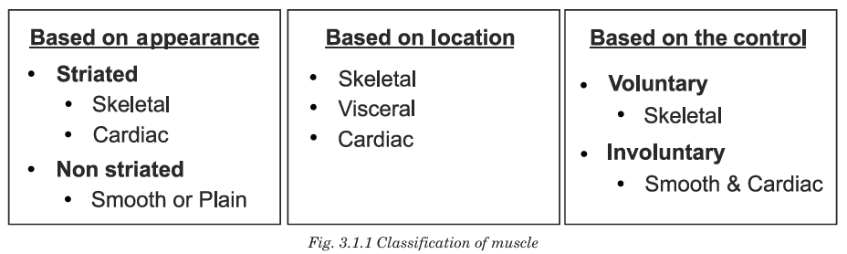

Slide 5
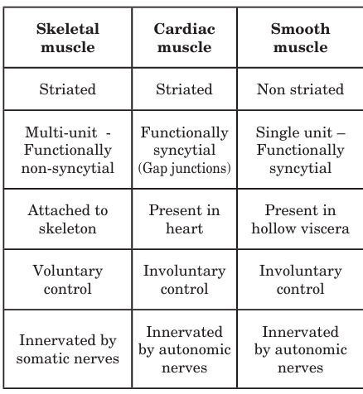

Slide 6
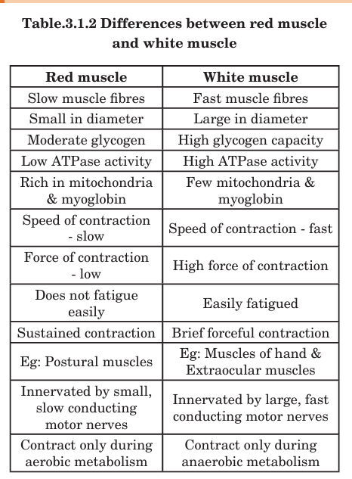

Slide 7
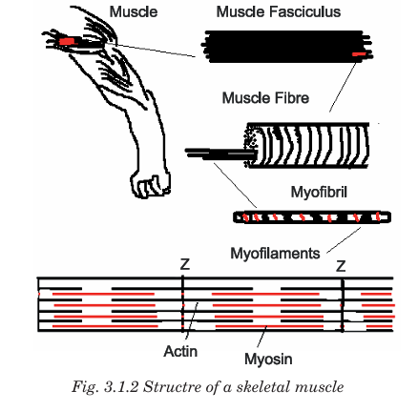

Slide 8
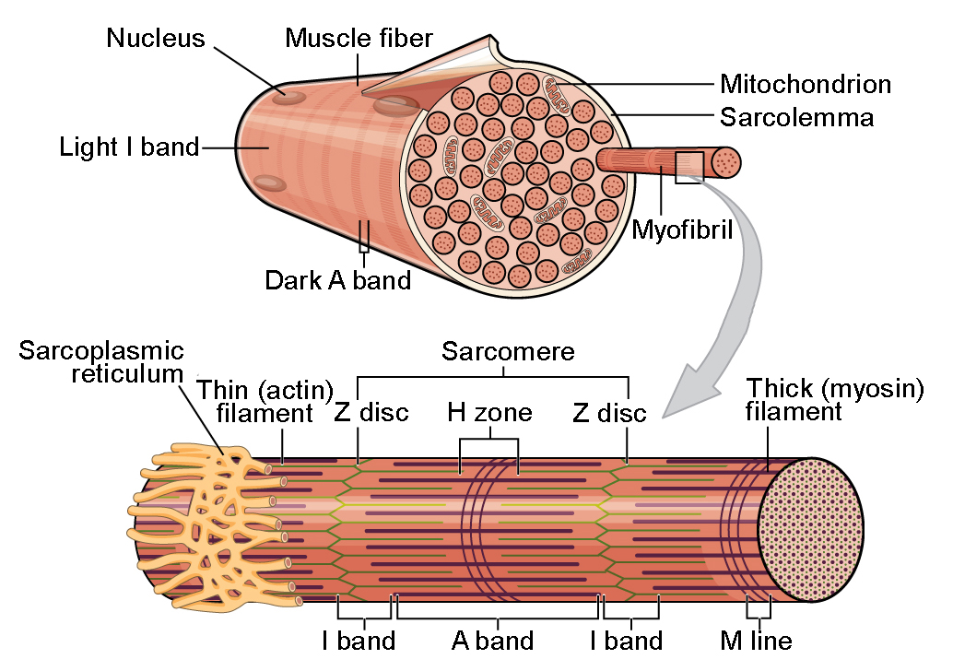

Slide 9
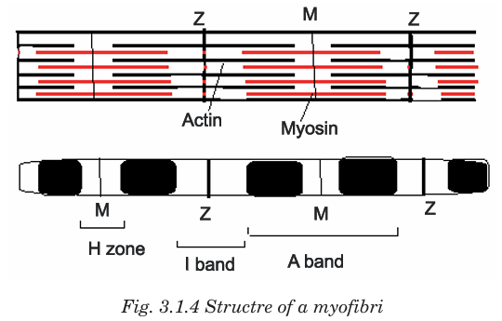

Slide 10
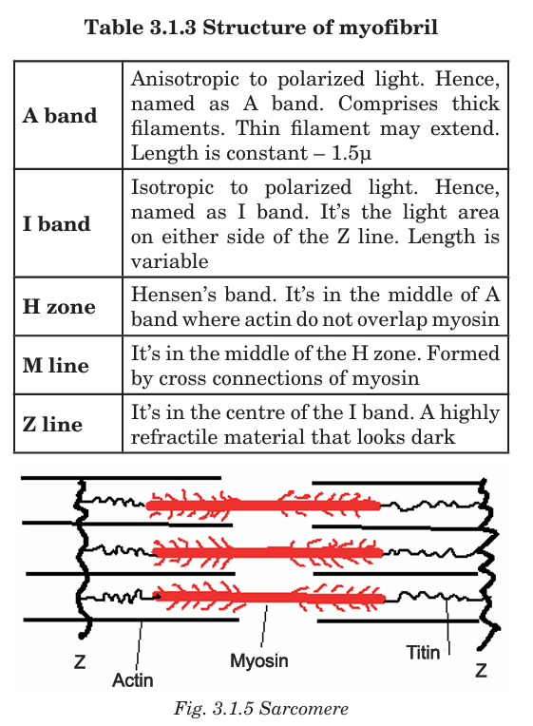

Slide 11
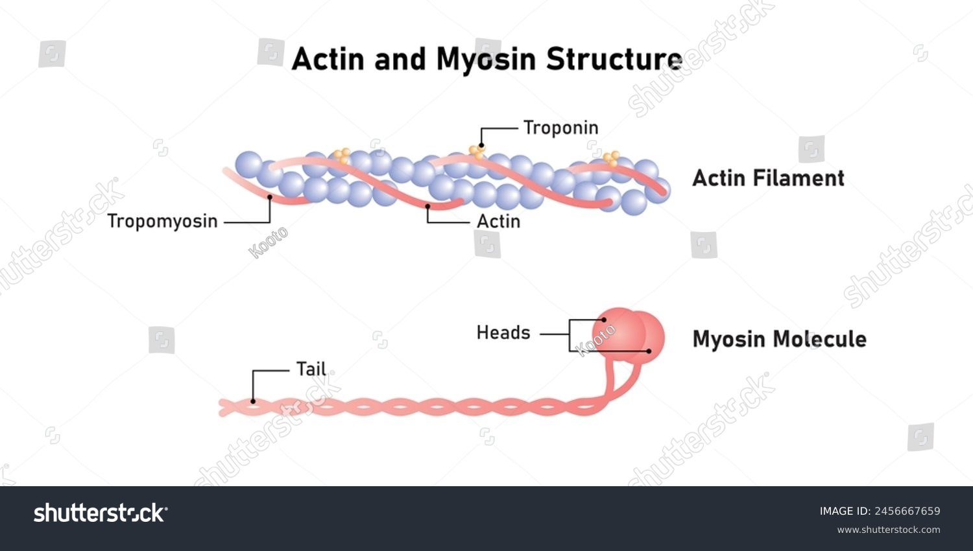

Slide 12
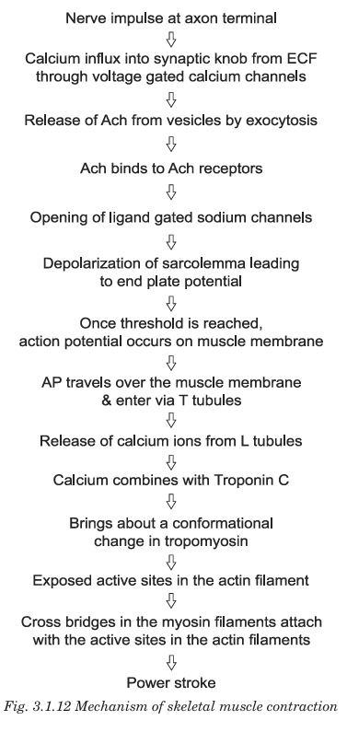

Slide 13
Rigor mortis
Rigor mortis is the post-mortem stiffening of muscles after death due to loss of ATP and formation of permanent actin–myosin cross-links.
It is one of the most important post-mortem changes used in forensic medicine to estimate time since death.
Cause / Mechanism
After death:
Circulation stops → no oxygen supply
ATP (energy) production stops
Calcium accumulates in muscles
Actin and myosin filaments form permanent bonds
Muscles become stiff and hard → Rigor mortis
Rigor persists until muscle proteins break down during decomposition.

Slide 14
Unit 2

Slide 15
Skeletal muscle
Skeletal muscle is a type of striated muscle that is usually attached to bones by tendons. It is voluntary, meaning its contraction is consciously controlled. Skeletal muscles are responsible for movement of the skeleton, maintenance of posture, and heat production during activity.
Structure
Muscle Fiber (Cell): Long, cylindrical, multinucleated cells.
Myofibrils: Cylindrical structures within fibers made of sarcomeres (contractile units).
Sarcomere: Basic functional unit, composed of actin (thin filament) and myosin (thick filament), giving the striated appearance.
Connective Tissue Layers:
  Endomysium – surrounds each fiber.
  Perimysium – surrounds a bundle of fibers (fascicle).
  Epimysium – surrounds the whole muscle.
Tendons: Connect muscle to bone.

Slide 16
Properties of Skeletal Muscle
Skeletal muscles exhibit several key physiological properties:
Excitability (Irritability)
  Ability to respond to a stimulus, usually a nerve impulse.
  Muscle fiber generates action potential in response.
Contractility
  Ability to shorten forcibly when stimulated.
  Unique to muscle tissue among body tissues.
Extensibility
  Ability to stretch without damage.
  Allows muscles to lengthen when opposing muscles contract.
Elasticity
  Ability to return to original length after stretching or contraction.
  Important for maintaining posture and smooth movements.
Conductivity
  Ability to propagate an action potential along the muscle fiber membrane (sarcolemma).
Tonicity (Muscle Tone)
  Even at rest, some fibers are slightly contracted, maintaining posture and readiness for action.

Slide 17
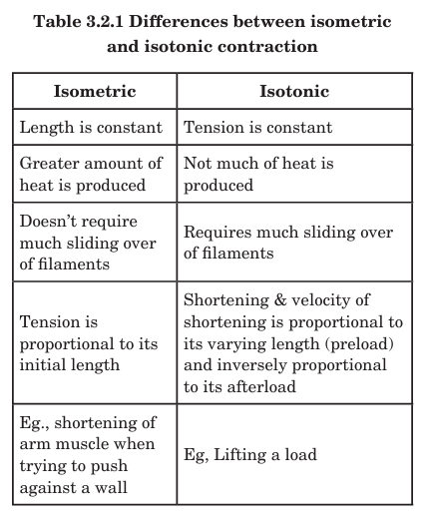

Slide 18
Thermal changes during muscular contraction
Resting heat is the heat produced at rest. This is due to the basal metabolic process in the muscle. Initial heat: is the heat that is produced during contraction. It is of two types: (i) Heat of activation is the heat that is liberated when calcium is released before the actual shortening. (ii) Heat of shortening is the heat that is liberated during contraction. This is due to various structural changes that take place during contraction. Heat of relaxation is the heat that is liberated during relaxation. Recovery heat is the heat that is produced after the end of muscular activity. It is due to chemical processes involved in re synthesis

Slide 19
Unit 3

Slide 20
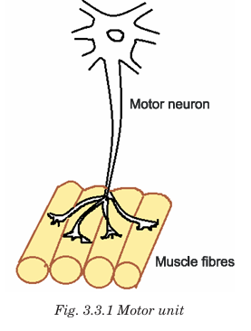
Neuromuscular junction
The neuromuscular junction is a specialized synapse between a motor neuron and a skeletal muscle fiber. It is the site where nerve impulses are transmitted to the muscle, initiating contraction.

Slide 21
Structure of NMJ
Presynaptic Terminal (Motor Neuron Ending)
  Contains synaptic vesicles filled with the neurotransmitter acetylcholine (ACh).
  Has voltage-gated calcium channels for calcium influx.
Synaptic Cleft
  A small gap (~50 nm) between neuron and muscle fiber.
  Contains acetylcholinesterase (AChE), which breaks down ACh to terminate the signal.
Postsynaptic Membrane (Motor End Plate)
  Specialized part of the muscle fiber membrane (sarcolemma).
  Contains nicotinic acetylcholine receptors (nAChR).
  Has junctional folds to increase surface area for receptor density.

Slide 22
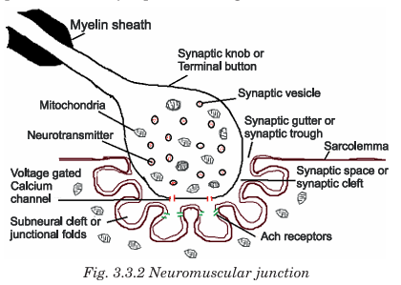

Slide 23
Mechanism of Transmission
Action Potential Arrival: Nerve impulse reaches presynaptic terminal.
Calcium Influx: Voltage-gated calcium channels open; Ca²⁺ enters the terminal.
ACh Release: Calcium triggers exocytosis of acetylcholine into the synaptic cleft.
Receptor Binding: ACh binds to nicotinic receptors on the motor end plate.
Depolarization: Sodium ions (Na⁺) enter the muscle fiber → end-plate potential.
Muscle Action Potential: If threshold is reached, an action potential propagates along the sarcolemma → muscle contraction.
ACh Breakdown: Acetylcholinesterase in synaptic cleft hydrolyzes ACh → stops stimulation.

Slide 24
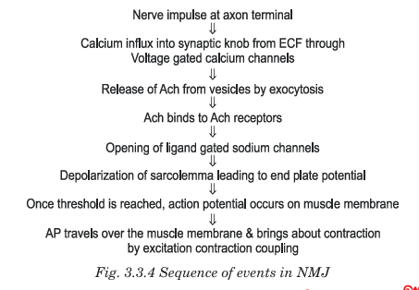

Slide 25
Drugs acting at neuromuscular junction
Drugs acting at neuromuscular junction may either block the neuromuscular transmission or stimulate transmission. Botulinum toxin, a bacterial toxin (Clostridium botulinum) inhibits synthesis and/ or release acetylcholine and leads to paralysis of the muscle. Tubocurarine and Gallamine combine with acetylcholine receptors reversibly by competitive inhibition. α Bungarotoxin (venom of krait) binds with acetylcholine receptors irreversibly by substrate competition and causes paralysis. Succinylcholine and decamethonium block transmission by persistent depolarization of the postsynaptic membrane. Neostigmine and physostigmine are anticholinesterases which prevent destruction of acetylcholine by cholinesterase. These drugs have temporary action and are reversible. Organophosphorus compounds namely di isopropyl fluorophosphate, tetraethyl pyrophosphate which are used in insecticides inactivate acetylcholinesterase in an irreversible manner and hence proves to be fatal by causing depolarising block.

Slide 26
Myasthenia gravis
An autoimmune disorder of the neuromuscular junction, characterized by weakness and rapid fatigue of voluntary muscles due to antibodies against acetylcholine (ACh) receptors or associated proteins at the motor end plate.
Pathophysiology
Autoantibodies target:
  Nicotinic ACh receptors (most common)
  Muscle-specific kinase (MuSK) in some cases
This reduces functional ACh receptors, impairing neuromuscular transmission.
Leads to decreased end-plate potential, muscle weakness, and fatigability.

Slide 27
Myasthenia gravis
Myasthenia gravis (myo – muscle; asthenia – weakness; gravis - grave) is an autoimmune disorder involving the neuromuscular junction. In this condition, antibodies are produced against the acetylcholine receptors. Clinical features include extreme muscle weakness and early fatigue of the muscles when repeated contractions are attempted. These patients may have an enlarged thymus. The most commonly affected muscles are extraocular and facial muscles leading to diplopia, ptosis etc., and muscles of deglutition and mastication. In severe cases, patients die of respiratory muscle paralysis. Treatment is drugs like neostigmine and physostigmine, anticholinesterases, steroids to decrease the antibody titre and thymectomy to reduce the T cells.

Slide 28
Unit 4

Slide 29
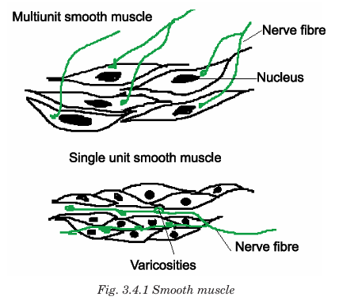
Smooth muscle
Smooth muscle has contractile proteins, but it is irregularly arranged and hence, non-striated. Smooth muscle cells are fusiform in shape with a centrally placed nucleus. Contraction is involuntary, slow, and long lasting. Smooth muscle is called the visceral muscle as it is seen in the hollow viscera

Slide 30
Structure of smooth muscles
Muscle Fiber (Cell)
  Spindle-shaped, single nucleus located centrally.
  Smaller than skeletal muscle fibers.
Contractile Proteins
  Actin and myosin filaments are present but not arranged in sarcomeres, so no striations.
  Dense bodies in cytoplasm and dense plaques on membrane anchor actin filaments (analogous to Z-discs).
Cytoskeleton
  Intermediate filaments (desmin, vimentin) connect dense bodies and plaques, transmitting force throughout the cell.
Gap Junctions (in unitary smooth muscle)
  Allow electrical coupling → coordinated contraction of multiple cells.

Slide 31
2. Mechanism of Contraction of Smooth Muscle
Unlike skeletal muscle, smooth muscle contraction is slower, prolonged, and does not require sarcomeres.
Steps of Contraction
Excitation
  Smooth muscle can be excited by:
    Autonomic nerves (neurotransmitters like ACh, norepinephrine)
    Hormones (e.g., vasopressin, angiotensin II)
    Stretch or local factors
Calcium Entry
  Ca²⁺ enters the cytoplasm via:
    Voltage-gated channels (from extracellular fluid)
    Release from sarcoplasmic reticulum
Activation of Calmodulin
  Ca²⁺ binds to calmodulin (instead of troponin in skeletal muscle).
Activation of Myosin Light Chain Kinase (MLCK)
  Ca²⁺–calmodulin complex activates MLCK.
  MLCK phosphorylates myosin light chains, activating myosin heads.
Cross-Bridge Cycling
  Activated myosin binds to actin → power stroke → sliding of filaments → contraction.
Relaxation
  Ca²⁺ removed via pumps to extracellular space or SR.
  Myosin light chain phosphatase dephosphorylates myosin → relaxation.

Slide 32
